Slide 1
Principal Component Analysis (PCA)
By: Anubhav Darisi, Akash Jayasuri,
Chenyue Huang, & Muhammed Mosaad
On 4/16

Slide 2
PCA Purpose and Introduction
It is easy to plot traits of one or two characteristics of something you are trying to measure
You can also see the relation between them
However when it goes to 3 or 4 traits(Xp) then it becomes harder to graph
It is also harder to see the relation
PCA helps us with that relation with many traits

Slide 3
PCA Analysis and Introduction
This is a process use to calculate the variance for each characteristic(p) in the data
It does this by reducing dimensionality for each trait
This is very useful to see how the data is scattered, and seeing whether or not there are any relationships
For example it can be used with Covid-19 data to see if any characteristics would lead to higher susceptibility of the disease, or a person’s health condition
Used to make many inferences in the real world

Slide 4
Methods and Materials
To portray how to execute Principal Component Analysis, we used covid cases in New Jersey in 2019 as our sample data. The data was collected from COVID-19 Tracking project and NYTimes. Before showing the execution of the code, we first explained the framework of PCA, which consists of standardization, covariance matrix computation, and eigenvalue and eigenvector computation. We went in depth on the step-by-step process regarding calculations, analysis, plotting and interpreting.

Slide 5
PCA Analysis(Basic Graphical Analysis)
The first data point will have the highest PCA, or variance, second highest and so on
It is mostly like a downward exponential graph in terms of variance
It is measured through eigenvalues and eigenvectors

Slide 6
PCA Analysis(Basic Graphical Analysis)
Calculate average measurements of each trait(Xp)
With average values, calculate the center of data
Shift data so center of data is origin(0,0)
Shift all the other data points along with it
Then find Line of Best Fit….
But how does it decide which is the Line of Best Fit?

Slide 7
PCA Analysis(Basic Graphical Analysis)
First project the points on the line of best fit(Do this by projecting line in an orthogonal line from each point to line to see where the data point best fits on PCA line of fit)
Measure distance from each data point to point on PCA line from step above
Then find the line that minimizes or maximizes the distance from the points
PCA is found by by maximizing the sum of squared distances from projected points to the origin
Largest sum of squared distances is the best line, which is first principal component

Slide 8
PCA Analysis(Basic Graphical Analysis)
Now find slope of line for PCA1, as well as rise over run
Use pythagorean theorem to find c, with a being run and b being rise
Finally divide a,b,c all by c, so you have a/c, b/c, c/c(which is 1)
This leads to EIGENVECTOR, with a/c value and b/c value
Square root of eigenvector is a singular value

Slide 9
Eigenvalues and Eigenvectors - Purpose
To understand PCA completely, we must understand its framework.
This is where eigenvalues and eigenvectors come into play.
Eigenvalues and eigenvectors are an efficient way to reduce the dimension size of the data being worked on.
Eigenvalues are the variances of the principal components.

Slide 10
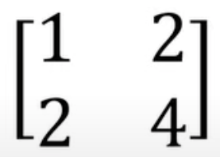

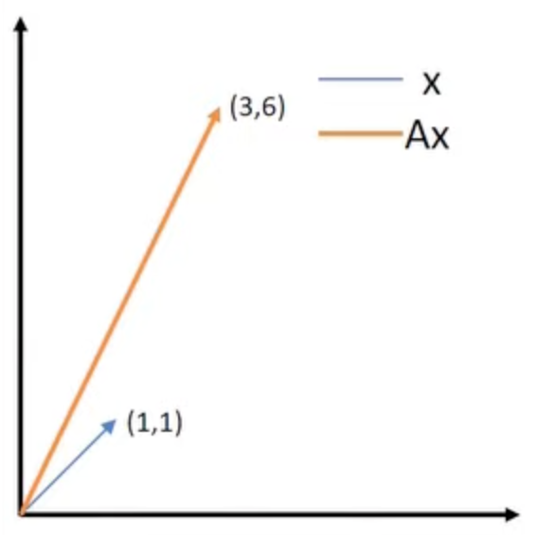

Eigenvalues and Eigenvectors - Example 1
To give a more specific example, suppose you’re multiplying a matrix with a vector
( ). Let’s say the matrix is and your vector is . If you multiply
these two together, it’ll produce a graph
that would look like this
Mx
Notice how the vector(Mx) is scaled AND rotated.
Now...

Slide 11
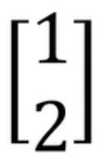
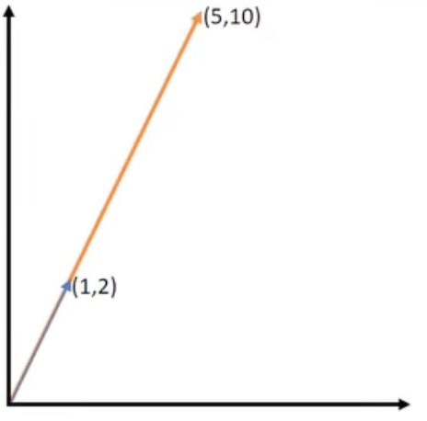
Eigenvalues and Eigenvectors - Example 1
Suppose you have the same matrix, but this time the vector you’re multiplying it
with is . When multiplied, the graph will look like this
Notice how this time, the vector is scaled but NOT rotated

Slide 12
Eigenvalues and Eigenvectors - Definitions
A vector that subjects to pure scaling and DOESN’T result in rotation is known as the eigenvector.
The scaling factor (the scalar in which the vector stretches) is known as the eigenvalue.

Slide 13
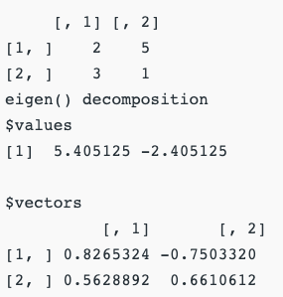
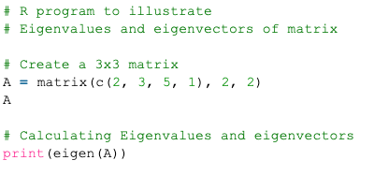
Eigenvalues and Eigenvectors - Example 2
The technique of eigenvectors and eigenvalues are used to compress the data. As mentioned before, the core of PCA is built on the concept of eigenvalues and eigenvectors, which reduce the dimensions. To calculate the eigenvalue, you use the formula Ax = ƛx, where ƛ is the eigenvalue. In R code, you would just use the “eigen ()” function to get the values.
EXAMPLE:
Code:
Output:

Slide 14
Interpreting Graphs
Scree Plot
Shows number of principal component versus its corresponding eigenvalue
Orders eigenvalues in descending order
Score Plot
Graphs scores of second versus first principal component
Loading Plot
Graphs coefficients of each variable for the first component versus that of the second component
Biplot
Combines the score and loading plots

Slide 15
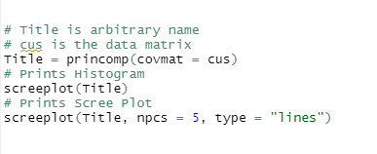
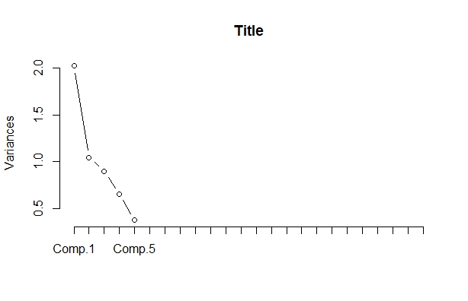
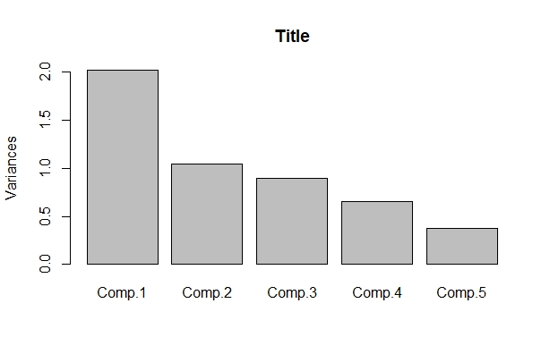
Scree Plot
As the plots show...
1 PC equates to an eigenvalue of 2
2 PC equate to an eigenvalue of 1
3 PC ~ 0.8
4 PC ~ 0.65
5 PC ~ 0.4

Slide 16
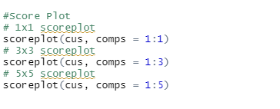
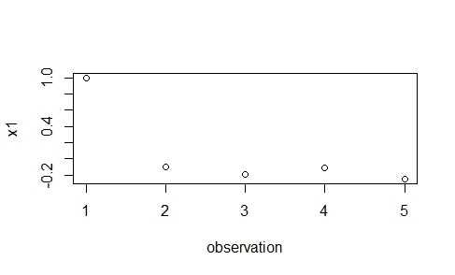
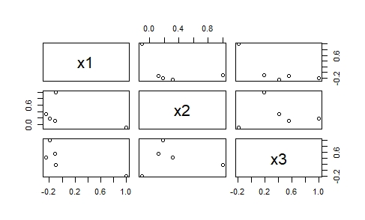
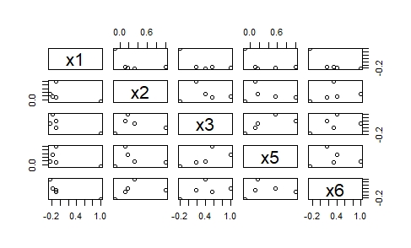
Score Plot
3x3
5x5
1x1

Slide 17
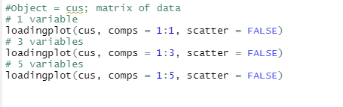
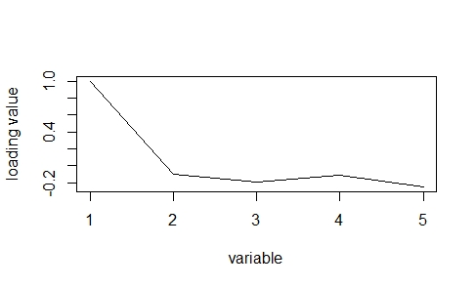
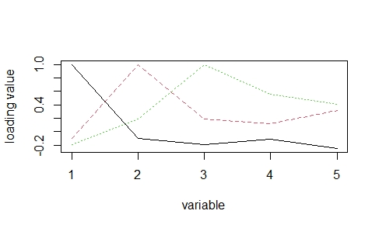
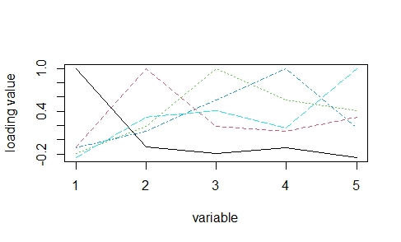
Loading Plot
5x5
3-variables
5-variables
1-variable

Slide 18
Singular-Value Decomposition
What is it?
SVD is probably the most known and widely used matrix decomposition method
Also known as matrix factorization, matrix decomposition involves describing a given matrix using its constituent elements
Purpose:
Facilitate/decompose subsequent matrix calculations
Provides another way to factorize a matrix, into singular vectors and singular values
Allows us to discover the eigendecomposition

Slide 19
Calculation variance(Conceptual)
Find PC2 using same approach
PC2 is perpendicular to PC1
So the slope of PC2 is opposite and reciprocal of PC1
This would make our eigenvector -b/c and a/c(from slide 8)
It has second most variance

Slide 20
Calculation variance(Conceptual)
If you have 3 or more components…
Then use the same approach for PC1 and PC2,so...
Find the best fitting line by using max distance from project points on PCA line to origin(PCA1)
Then find perpendicular line(PC2)
Do PC3 using same thing by finding best fitting line that is perpendicular to PC1 and PC2
Keep repeating this for 4 and so on

Slide 21
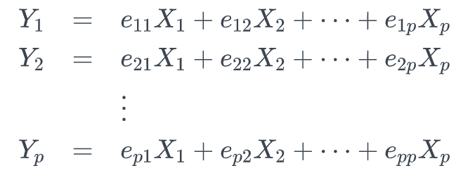
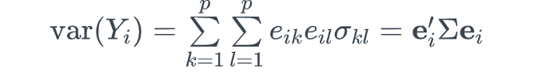
PCA(Multivariate process)
Assume X is a random vector [X1,X2,...Xp] of row vectors with covariance matrix, sigma and eigenvalues from lambda1, lambda2,...lambda all greater than 0
All of the e variables can be viewed as regression coefficients
Y is function of random data, and it has population variance:

Slide 22

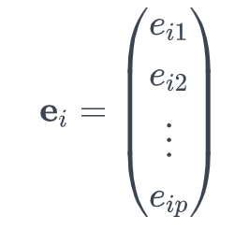
PCA(Multivariate process)
Yi and Yj(i being row of y and j being column of y1 matrix) have population matrix, do this process known as eigenvalue decomposition
eij becomes one vector, which is how you find eigenvalues for the PCA components

Slide 23
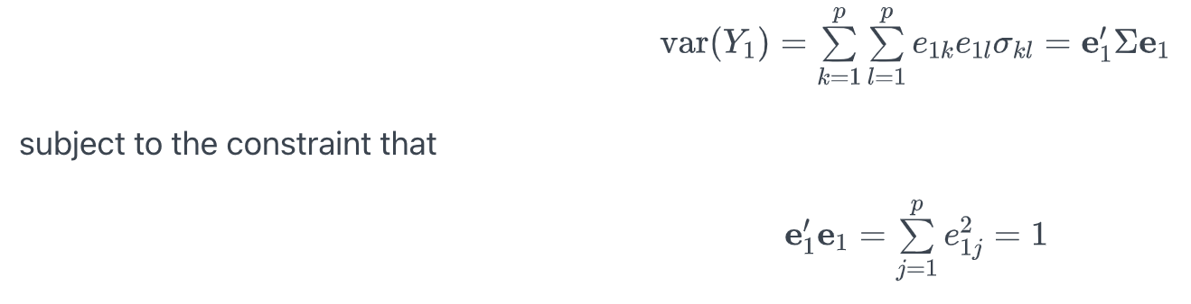
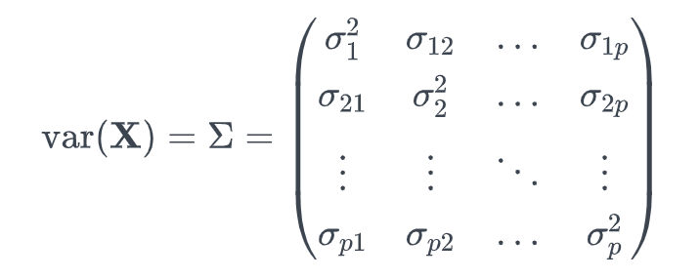
PCA(Multivariate process)
As remembered from the conceptual process, we have to maximize the variance of the variance principal component(it has most variance)
Now we are doing:
Sigma(k=l) is the elements from covariance matrix from the X matrix, so it would like this
The variances will be multiplied, since you are looking at sigma11,which is sigma1^2, sigma22 which is sigma2^2, up until p which is the last variance

Slide 24
PCA(Multivariate process)
As we remember, we wanted to maximize the sum of squares from projected points on PCA graph to origin
Here, we are maximizing the variance with the restraint that the sum of squared coefficients of eigenvalues in e1 add to 1
Instead of guessing points on a graph with a Best line of Fit, the difference is that now we are doing it with eigenvalues from each Y equation given
Do the same with all other eigenvalues to find PCA
The difference here is that you are now testing an eigenvector to see its best fit rather than a data point

Slide 25
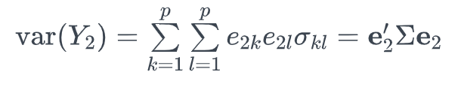
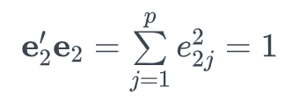
PCA(Multivariate process)
For the second component, some parts of the process are the same and some have differences
We are looking at the second eigenvector
The maximizing variance is the same, so it is still
We are also taking in the variances from the X matrix with sigma variable again
The squared coefficients of e2 will equal 1

Slide 26
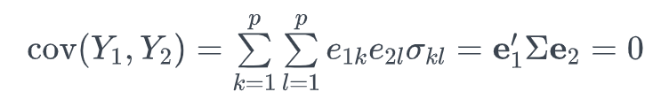
PCA(Multivariate process)
The additional constraint is that the covariance of Y1 and Y2 are uncorrelated, which includes each of its eigenvectors
Making it equal to 0 makes Y2 and Y1 perfectly uncorrelated, hence if you remember from the conceptual process, first two PCAs are perpendicular
This is because e1 and e2 are opposites and reciprocal, which creates orthogonality

Slide 27
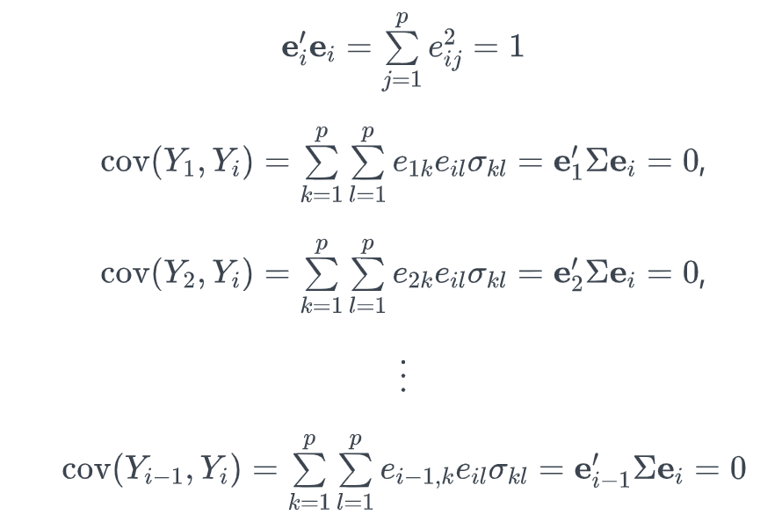
PCA(Multivariate process)
Remember for the graphical analysis we find the best fitting line that is perpendicular to PC1 and PC2?
And in terms of eigenvalues remember we made it equal to 0 when they are perpendicular for PC2 and PC1 = 1?
Same thing applies, here we take into account all the previous Y covariances and take eigenvectors which are as uncorrelated as previous ones
This means that it is equal to 0, as 0 is perpendicular, and we just keep repeating the process

Slide 28
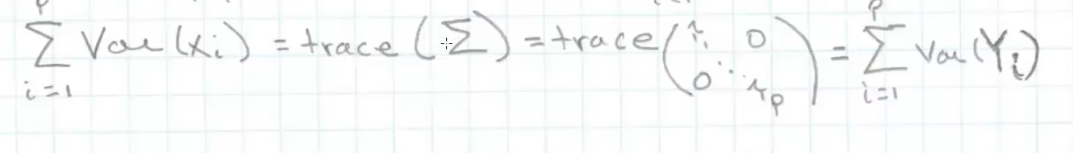
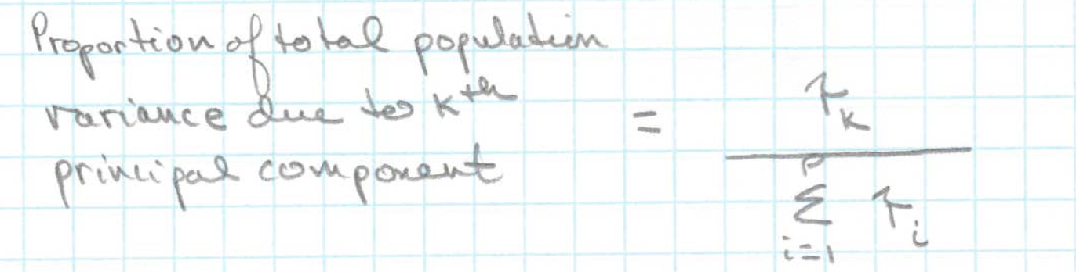
PCA(Multivariate process)
Let Sigma(p x p) matrix have a eigenvalue-eigenvector pair (lambda, ei), then the ith component be given by Y- = eT * X matrix
Because of this , Var(Yi) = eT*sum of all es which is equal to lambai with covariance(Yi, Yk)
Total population variance = summation of Lamdai values

Slide 29
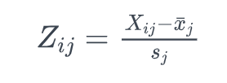
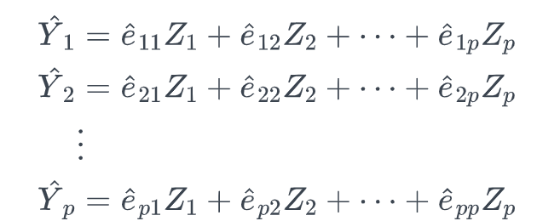
Standardized Variables
We choose to standardize variables fi they are measured on scales with differing ranges
Xij is equal to data for j in unit i of X matrix
X bar j is mean vector x’s variable j
Sj is sample standard deviation
Equation is similar to regular PCA

Slide 30
PC for Covariance Matrices with Special Structure
Find Special Structure Situation
First patterned covariance matrix
Second patterned covariance matrix
If X is normal distributed the contours of constant density are ellipsoids
If the standardized variables Z1, … , Zp have a multivariate normal distribution with a covariance matrix given by 8-15, then the ellipsoids of constant density are “cigar shape”
Things to consider:
The amount of total sample variance explained
The relative sizes of the eigenvalues (the variances of the sample components)
The subject-matter interpretations of the components
Etc.

Slide 31
The Number of Principal Components
Method
Scree plot
With the eigenvalues ordered from largest to smallest
Look for elbow (bend)
The number of components is taken to be the point at which the remaining eigenvalues are relatively small and all about the same size

Slide 32
Graphing Principal Components
Purpose
To reveal suspect observations
check on the assumption of normality (often verify the first few principal components are approximately normally distributed) can be used as the input data for additional analysis

Slide 33
Graphing Principal Components
Steps
To help check the normal assumption, construct scatter diagrams for pairs of the first few principal components, make qqplots from the sample values generated by each pc
Construct scatter diagrams and qqplots for the last few pc, help to identify suspect observations
Aware
There are linear dependencies among the residuals from a linear regression analysis, the last eigenvalues will by zero, within rounding zero

Slide 34
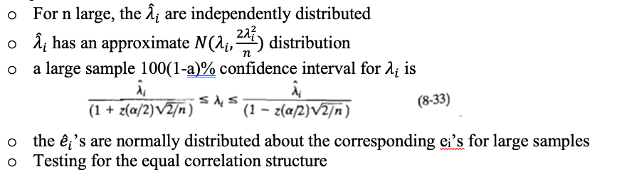
Large sample inference

Slide 35
Prcomp
Principal component based regression methods, including principal component regression (PCR) and partial least squares regression (PLS).
These methods are very useful for multivariate data containing correlated predictors.
The presence of correlation in the data allows to summarize the data into few non-redundant components that can be used in the regression model.
Compared to ridge regression and lasso (Chapter @ref(penalized-regression)), the final PCR and PLS models are more difficult to interpret, because they do not perform any kind of variable selection or even directly produce regression coefficient estimates.

Slide 36
Prcomp code
us <- read_excel("Desktop/490 project/us_states_covid19_daily.xlsx")
cus<-us[,2:13]
nrow(us)
prcomp(na.omit(cus), scale=TRUE)
prus<-prcomp(na.omit(cus), scale=TRUE)
dim(prus$rot)
prus$rot
dim(prus$x)
summary(prus)
round(prus$rot[,1],2)
prusc<-prcomp(na.omit(cus))
summary(prusc)
round(prusc$rot[,1],2)
round(prusc$rot[,2],2)
t(prusc$rot[,1]) %*% prusc$rot[,2]

Slide 37
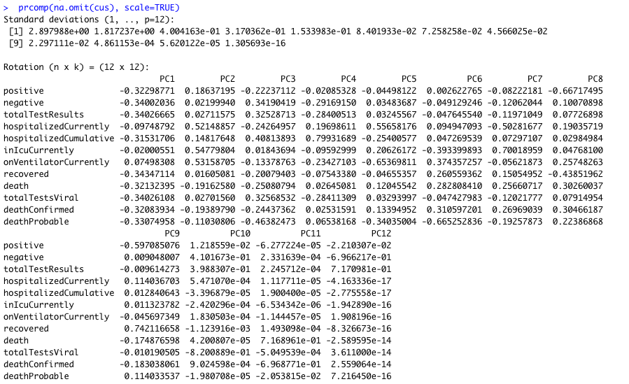
Prcomp output

Slide 38
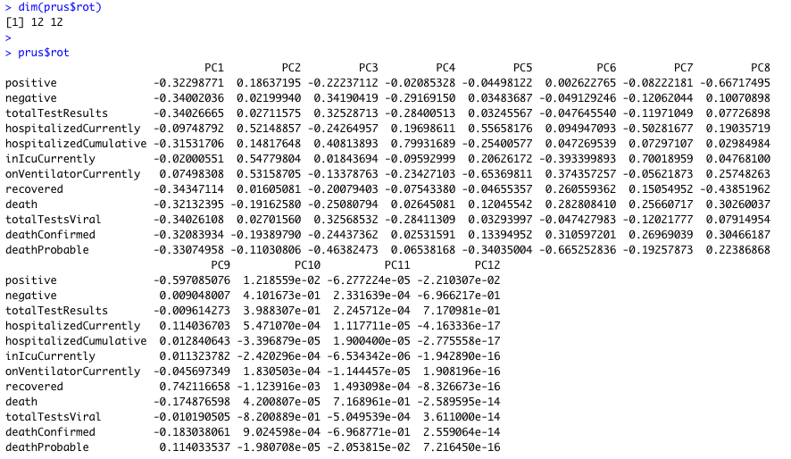
Prcomp output

Slide 39
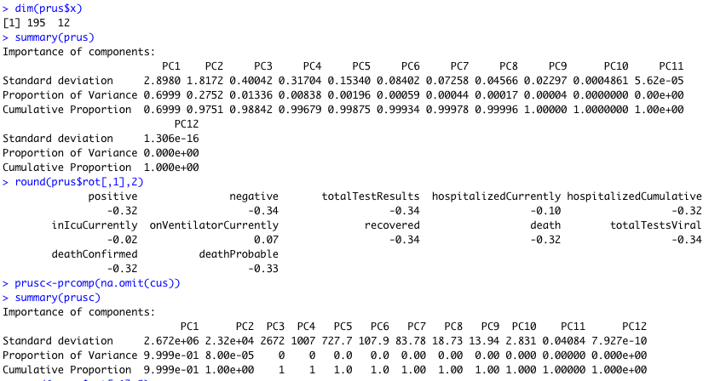
Prcomp output

Slide 40
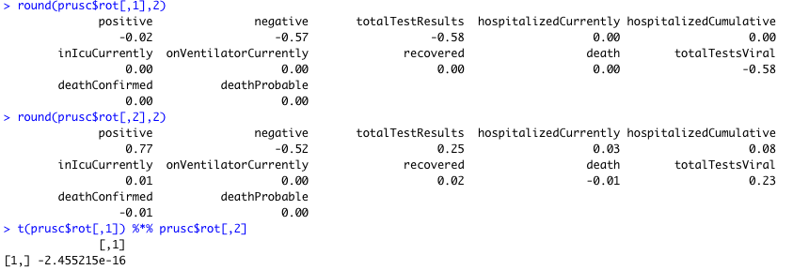
Prcomp output

Slide 41
Prcomp Output Result
We have 12 combinations of linear components, since we have 13 variables for out covid data
Each value entered in the PCA for each variable is the principal component on a 12 x 12 dimension, these are the eigenvectors
The eigenvectors under each PC show what percentage of each variable makes up of that Principal Component
Looking at PC1 for example, we can see that people currently on a ventilator make up 0.07498308
Looking at the standard deviations, we can see that the positive and negative people tested for covid have the highest standard deviations
The lowest standard deviation is the probable death count, as most of the numbers are around 1400-1800
This is expected as the probable death count would usually be an estimate, while positive and negative people tracked for covid would change daily

Slide 42
Prcomp Output Result
In the prus, the proportion of variance indicates how much of total variance is there in variance of a particular principal component. Hence, PC1 variability explains 70% of total variance of the data.
Considering rotations of PC1, one can conclude that “positive” , “negative”, “totalTestResults”, “hospitalizedCurrently”, etc. are not directly related, and they all are inversely related to “onVentilatorCurrently”(which has a negative value in rotation of PC1)
But the rotations of PC2 and PC8 are directly related with “positive” , “negative”, “totalTestResults”, “hospitalizedCurrently”, etc. but PC8 with inversely related to “positive” and “death”

Slide 43
Prcomp Output Result
The cumulative proportion variance indicates how much of the data is useful for calculating the PCA
When you look at the summary of PC analysis, you see that the value is 0.699 under PC1
This means than 69.9% of the data is useful in calculating PC1
The values will keep getting bigger as you add more PC components
They should add up or get very close to 1 since we have to maximize variance equal to 1, as seen in slide 20

Slide 44
Eigenvalues and Eigenvalues Decomposition
Code
(pc_us=prcomp(na.omit(cus)))
(pc_us_1st2=pc_us$rotation[,1:2])
(pc_us_eigen=pc_us$sdev^2)
summary(pc_us)
cor(pc_us$rotation)

Slide 45
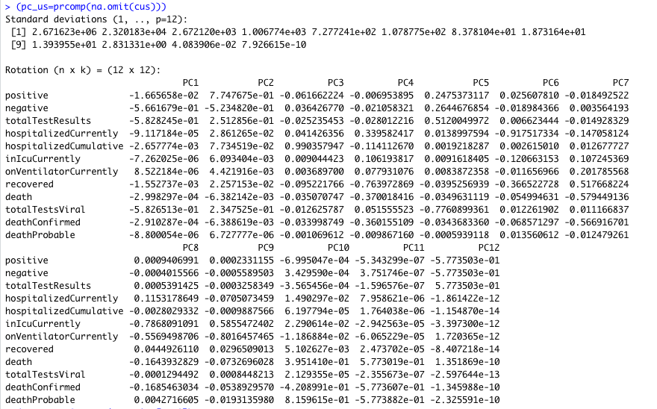
Eigenvalues and Eigenvalues Decomposition
output

Slide 46
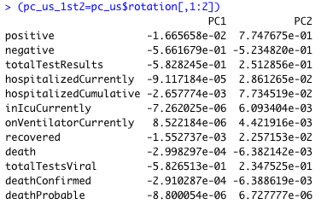
Eigenvalues and Eigenvalues Decomposition
Output

Slide 47
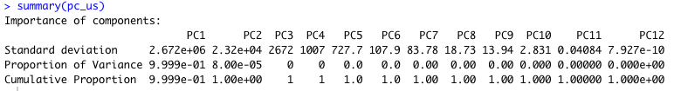
Eigenvalues and Eigenvalues Decomposition
Output

Slide 48
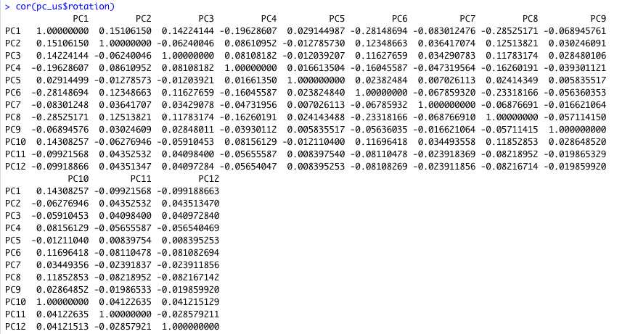
Eigenvalues and Eigenvalues Decomposition
Output

Slide 49
Questions for Thought
What happens if eigenvalues come out roughly equal?
Answer: PCA won’t be able to select the principal components because in that case, all principal components would be equal, and they need not be equal
T/F: The maximum variance for PCA analysis should add up to 1
Answer: True
When is PCA advised to be used, and not used?
Answer: PCA should be used for variables with strong correlation. However, if the relationship is weak, PCA won’t work well to achieve its function; data reduction

Slide 50
CITATIONS
11.1 - principal component Analysis (pca) Procedure: Stat 505. (n.d.). Retrieved April 16, 2021, from https://online.stat.psu.edu/stat505/lesson/11/11.1
11.2 - How do we find the Coefficients?: Stat 505. (n.d.). Retrieved April 16, 2021, from https://online.stat.psu.edu/stat505/lesson/11/11.2
11.5 - Alternative: Standardize the VARIABLES: Stat 505. (n.d.). Retrieved April 16, 2021, from https://online.stat.psu.edu/stat505/lesson/11/11.5
Find eigenvalues and eigenvectors of a matrix in r programming - eigen() function. (2020, June 19). Retrieved April 16, 2021, from https://www.geeksforgeeks.org/find-eigenvalues-and-eigenvectors-of-a-matrix-in-r-programming-eigen-function/
Jaadi, Z. (n.d.). A step-by-step explanation of principal component Analysis (PCA). Retrieved April 16, 2021, from https://builtin.com/data-science/step-step-explanation-principal-component-analysis
Joshstarmer. (2018, April 02). StatQuest: Principal component ANALYSIS (pca), step-by-step. Retrieved April 16, 2021, from https://www.youtube.com/watch?v=FgakZw6K1QQ&t=1064s
Srk. (2020, December 07). COVID-19 in USA. Retrieved April 16, 2021, from https://www.kaggle.com/sudalairajkumar/covid19-in-usa
Total variance explained. (n.d.). Retrieved April 16, 2021, from https://www.ibm.com/docs/en/spss-statistics/23.0.0?topic=reduction-total-variance-explained
Types of Graphs in R. (n.d.). Retrieved April 16, 2021, from https://www.rdocumentation.org/packages/pls/versions/2.7-3/topics/scoreplot

Slide 51
ACKNOWLEDGEMENTS
Anubhav: Slides 3,4, 6-9, 20-31, 43, 45 Introduction, Basic Graphical and Multivariate Process, Prcomp
Akash: Abstract (slide 2), Methods and Materials (slide 5), Eigenvalues and Eigenvectors (slides 10-14)
Muhammed: Interpreting Graphs and Rseek(slides 15-18), SVD (slide 19)
Chenyue: Slides 32-42, 44,46-50 Prcomp, Graphical Principal Components, Eigenvalues and Eigenvectors Decomposition
Collectively we did Questions

